Slide 1



UNIVERSITY INSTITUTE OF ENGINEERING
COMPUTER SCIENCE ENGINEERING
Bachelor of Engineering
Theory of Computation (CST-353)
Topic: Finite Automata
DISCOVER . LEARN . EMPOWER

Slide 2
Learning Objectives & Outcomes
Objective:
To understand the concept of Finite Automata, properties and limitation of Finite Automata.
Outcome:
Student will understand the
  Finite Automata- DFA, NFA
  Properties of FA

Slide 3
Finite Automaton (FA)
Finite automata is an abstract computing device. It is a mathematical model of a system with discrete inputs, outputs, states and a set of transitions from state to state that occurs on input symbols from the alphabet Σ.
Finite Automata Representation
The finite automata can be represented in three ways, as given below −
Graphical (Transition diagram)
Tabular (Transition table)
Mathematical (Transition function)

Slide 4
Formal definition of Finite Automata
Finite automata is defined as a 5-tuples
M=(Q, Σ, δ,q0,F)
Where,
Q: Finite set called states.
Σ: Finite set called alphabets.
δ: Q × Σ → Q is the transition function.
q0 ∈ Q is the start or initial state.
F: Final or accept state.

Slide 5
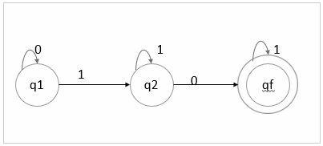
Finite Automata can be represented as follows −
Transition diagram
Transition table
Transition function
Transition Diagram
It is a directed graph associated with the vertices of the graph corresponding to the state of finite automata.
An example of transition diagram is given below −

Slide 6
Transition table
It is basically a tabular representation of the transition function that takes two arguments (a state & a symbol) and returns a value (the ‘next state’).
δ : Q × Σ → Q
In transition table, the following factors are considered −
Rows correspond to state.
Column corresponds to the input symbol.
Entries correspond to the next state.
The start state is marked with ->.
The accept state marked with *.

Slide 7
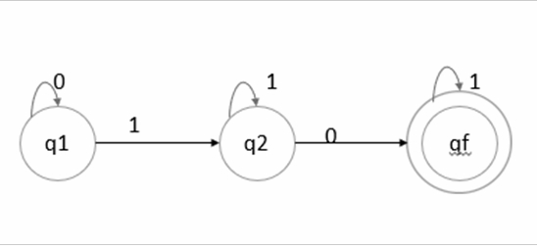
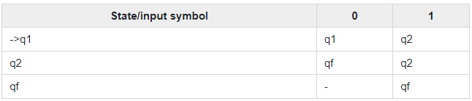
An example of transition table is as follows −
The transition table is as follows −

Slide 8
Transition function
The transition function is denoted by δ. The two parameters mentioned below are the passes to this transition function.
Current state
Input symbol
The transition function returns a state which can be called as the next state.
δ (current_state, current_input_symbol) = next_state
For example, δ(q0,a)=q1

Slide 9
Properties and Limitations of Finite State Machines
There are many properties available when defining an FSM. These properties are available at the various levels of the FSM hierarchy.
FSM Level Properties
State Properties
Resolution Action Properties
Transition properties
Event Type Properties
Event Context Properties

Slide 10
Disadvantages of Finite State Machine
The disadvantages of the finite state machine include the following
The expected character of deterministic finite state machines can be not needed in some areas like computer games
The implementation of huge systems using FSM is hard for managing without any idea of design.
Not applicable for all domains
The orders of state conversions are inflexible.

Slide 11
References
Https://en.wikipedia.org/wiki/Finite-state_machine
https://www.safaribooksonline.com
http://studentsfocus.com/
http://www.francisxavier.ac.in/

Slide 12
THANK YOU

